Slide 1

IMDB MOVIES PREDECTION
A.venu gopal

Slide 2
Problem Statement
ABC Movie Production Company approaches XYZ agency in the beginning of year 2017
ABC’s Aim: Produce Movies that earn highest Revenue, Rating and Critical Acclaim.
ABC’s Need: Find out characteristics of movies that earn highest Revenue, Rating and Critical Acclaim
ABC also wants to know:
Movie Industry Growth ?
Right time to invest in the Movie Industry ?

Slide 3
BACKGROUND
IMDB (Internet Movie Database): Popular online database for movies, television programs etc.
IMDB Registered users: Rate movies on a scale of 1 to 10.
IMDB Rating: Weighted-Mean Rating displayed beside each movie title.
Metascore: IMDB also displays rating from metacritic.com
IMDB Most Popular 1000 movies from 2006-2016 would be ideal to find insights for ABC’s need.

Slide 4
DATA IN DEPTH

Slide 5
DATA IN DEPT (…)
Consists of 1000 rows (movies) and 16 columns (Rank, Title, Rating etc)
% missing values in columns: Gross- 1.2% , Metascore - (1.4%),Certificate-1.2%
Filled missing values in columns:
Gross– by Mean Gross
Metascore – by Mean Metascore
Certificate - by Mean Certificate
After cleaning: 1000 rows and 16 columns
There is no incorrect datatypes.
The relationship of Genre, Director, Runtime of movies against Gross, Rating and Metascore could provide significant insights.

Slide 6
WHAT DID I DO ?
Examined the dataset
Cleaned up the dataset
Came up with several questions to find out the relationship of Genre, Director and Runtime of movies against Revenue, Rating and Metascore.
Explored the dataset based on the questions using descriptive statistics and visualization.
Drew conclusions from the exploration.
Found out actionable insights from conclusion.

Slide 7
WHAT DID I DO ? (…)
Explored the impact of Director on a movie’s Revenue, Rating and Metascore.
Classified the Runtime of a movie into 4 categories: Short, Medium, Moderately Long and Long
Analyzed movie’s Revenue, Rating and Metascore against these categories.
Explored the effect of Genre count on a movie’s Revenue, Rating and Metascore.
Explored the effect of Genre combination on a movie’s Revenue, Rating and Metascore.
Analyzed the growth of movie industry over the 10 year period in terms of Revenue and Rating.
Explored the correlation between Revenue, Rating and Metascore.

Slide 8
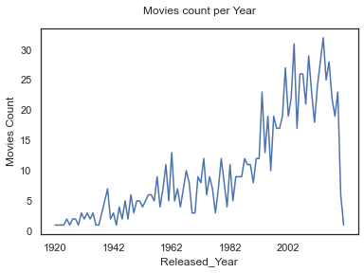
INDUSTRY GROWTH Y-ON-Y V/s MOVIE COUNT
Growing with respect to number of movies released.

Slide 9
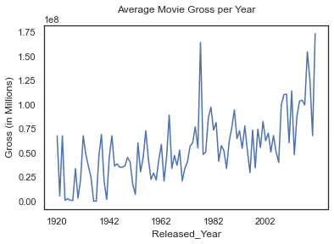
INDUSTRY GROWTH Y-ON-Y V/s TOTAL REVENUE
Growing in terms of Total Revenue per year

Slide 10
INDUSTRY GROWTH Y-ON-Y V/S AVERAGE REVENUE
Decreasing Trend.
Competition is increasing and more movies are released per year
Total revenue gets distributed among many movies.

Slide 11
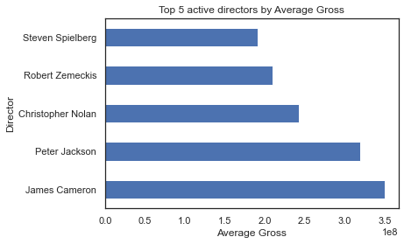
ACTIVE DIRECTOR V/s REVENUE
The top 5 active directors in terms of average revenue
James Cameron tops the chart.
Closely followed by Peter Jackson.

Slide 12
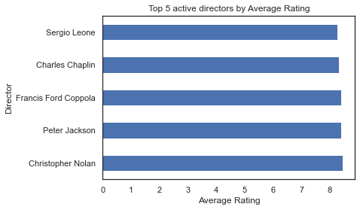
ACTIVE DIRECTOR V/s Rating
The top 5 active directors in terms of average rating
Christopher Nolan tops the list

Slide 13
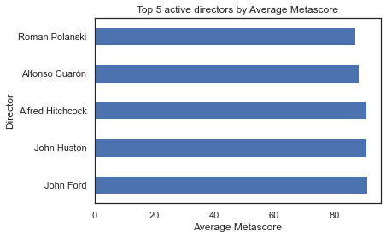
ACTIVE DIRECTOR V/s METASCORE
The top 5 active directors in terms of average metascore
John Ford tops the list
John Huston also features

Slide 14
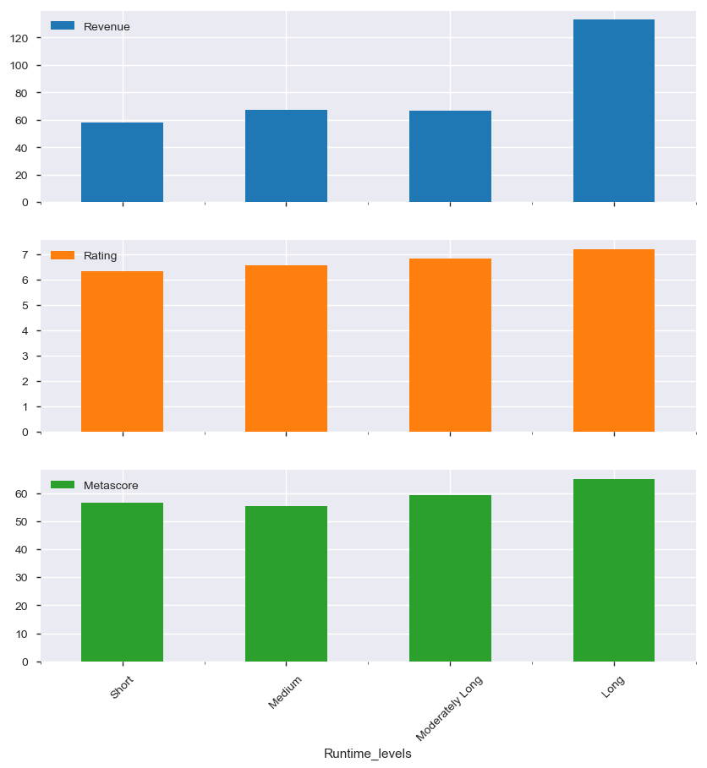
IMPACT OF MOVIE RUNTIME
Movies with ‘Long’ Runtimes (>123 minutes) earn more in terms of Revenue, Rating and Metascore
Revenue dramatically high for movies with Long Runtime.

Slide 15
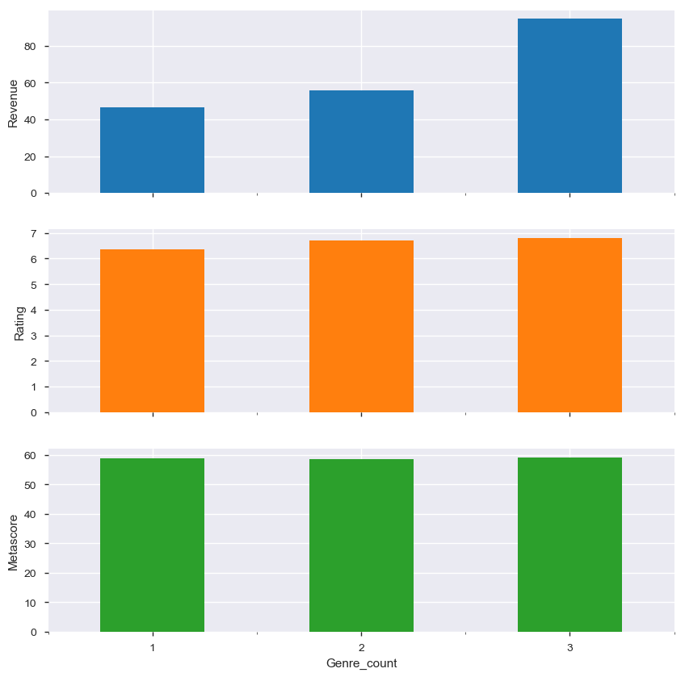
IMPACT OF GENRE COUNT
Movie’s Revenue, Rating and Metascore increases as the Genre count increases.
Genre count = 3 → Revenue significantly High

Slide 16
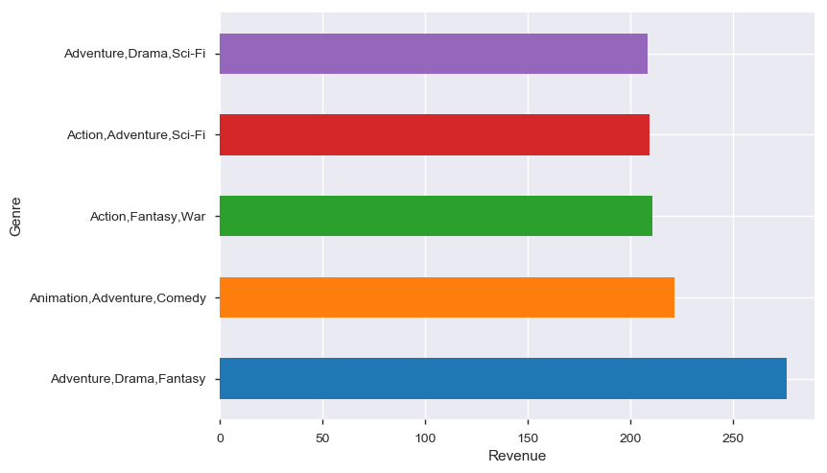
GENRE COMBINATION vs REVENUE
‘Adventure, Drama, Fantasy’ – earn highest average revenue
Adventure features more in the top 5

Slide 17
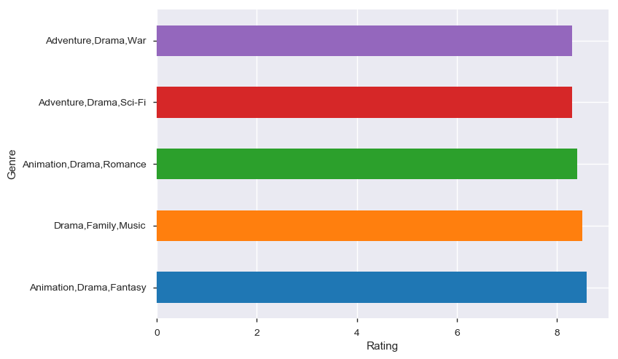
GENRE COMBINATION VS RATING
‘Animation, Drama, Fantasy’ – earn highest average rating
Drama is the most popular

Slide 18
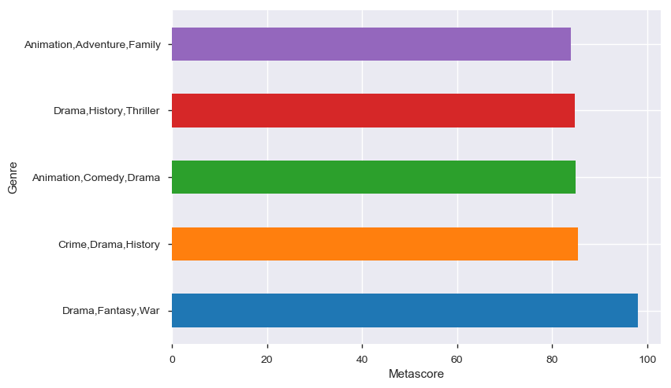
GENRE COMBINATION VS METASCORE
“Drama, Fantasy, War"– earn highest average metascore
Drama is the most popular among critics

Slide 19
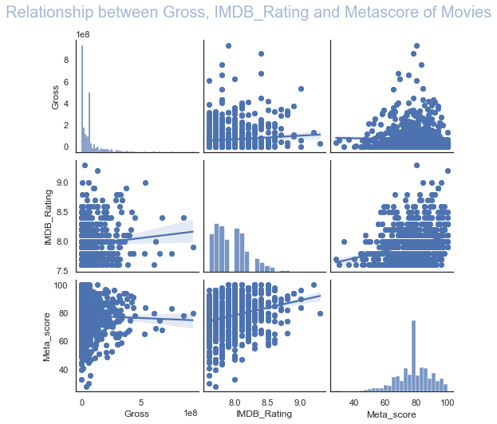
CORRELATION: REVENUE, RATING AND METASCORE
Rating and Metascore have strong correlation.
As the Rating increases, the Revenue also tend to increase
As the Metascore increases, the Revenue also tend to increase.
The IMDB users and Critics tend to agree with each other.

Slide 20
Conclusion
Director
The director who has earned the highest average revenue is James Cameron. However he has directed only 1 movie in the 10 year period.
Christopher Nolan's movies are the most popular among viewers as the average rating for his movies is the highest in the 10 year period.
Critics liked Barry Jenkins's movies the most. He is closely followed by Kenneth Lonergan and Todd Haynes
Looking at the Movie Industry Trend, most active directors are more favored.
Among the most active directors, J J Abrams's movies earn more in terms of Average Revenue
Christopher Nolan is the most popular active director in terms of Average Rating among people
With respect to Directors who are most active, critics favor David Fincher in terms of Average Metascore.

Slide 21
Runtime
Movies with Long runtimes (> 123 minutes) earn more in terms of Revenue, Rating and Metascore.
Revenue is dramatically high for movies with Long runtimes
Genre
As the Genre count increases in a movie, its Revenue, Rating and Metascore are on the rise.
However, revenue is significantly high for movies with Genre count of 3.
Adventure as Genre is a common factor for movies that brings in more Revenue, with the Genre combination of "Adventure, Drama, Fantasy" earning the highest Revenue
The most popular Genre is Drama and the Genre combination of "Animation, Drama, Fantasy" earns the highest Rating.
Again Drama is popular among Critics as well, with the Genre combination of "Drama, Fantasy, War" earning the highest Metascore

Slide 22
Industry Growth
Industry is growing with respect to number of movies released and the total revenue gained year on year.
However, the average revenue of movies year on year is showing a negative trend. This is probably because of increased competition and more movies released in the industry.
The popularity of movies is also showing a negative trend year on year. This is probably because of more movies released with Genre combinations which are unpopular among viewers.
Rating for movies in General
From the correlation graph, it is clear that People and Critics rate movies in a similar manner.
In general, movies with higher rating and metascore tend to earn more revenue as well.

Slide 23
Produce multiple movies with best features - The movie industry is growing very fast. More movies are released year on year and the competition is very high and the revenue is distributed among many movies. It would not be a good idea to wait for that ONE BIG MOVIE like Avatar (by James Cameron) that brings highest Revenue, Rating and Metascore. So, produce more movies using the best features (explained below) for reaping the maximum benefits.
Produce movies with active directors - those people who directs multiple moderately high budget movies. For instance, Christopher Nolan movies is certain to bring in more Revenue, Rating and Metascore.
Produce movies that have Long runtimes - Runtime greater than 2 hrs.
Produce movies with 3 Genre combination - Include a mix of Drama, Animation, Adventure, Sci-Fi, Fantasy. The movies should relate to audience with real life incidents, should move them to the edge of the seats and should enhance their imagination.
Produce movies that will satisfy both People and Critics - These movies will earn higher Revenue more often than not

Slide 24
THANKS
THANKING YOU

